Slide 1

Azure User Group Norway
Cost Optimization in the wild! Experiences from cutting costs
Erlend Rushfeldt

Slide 2
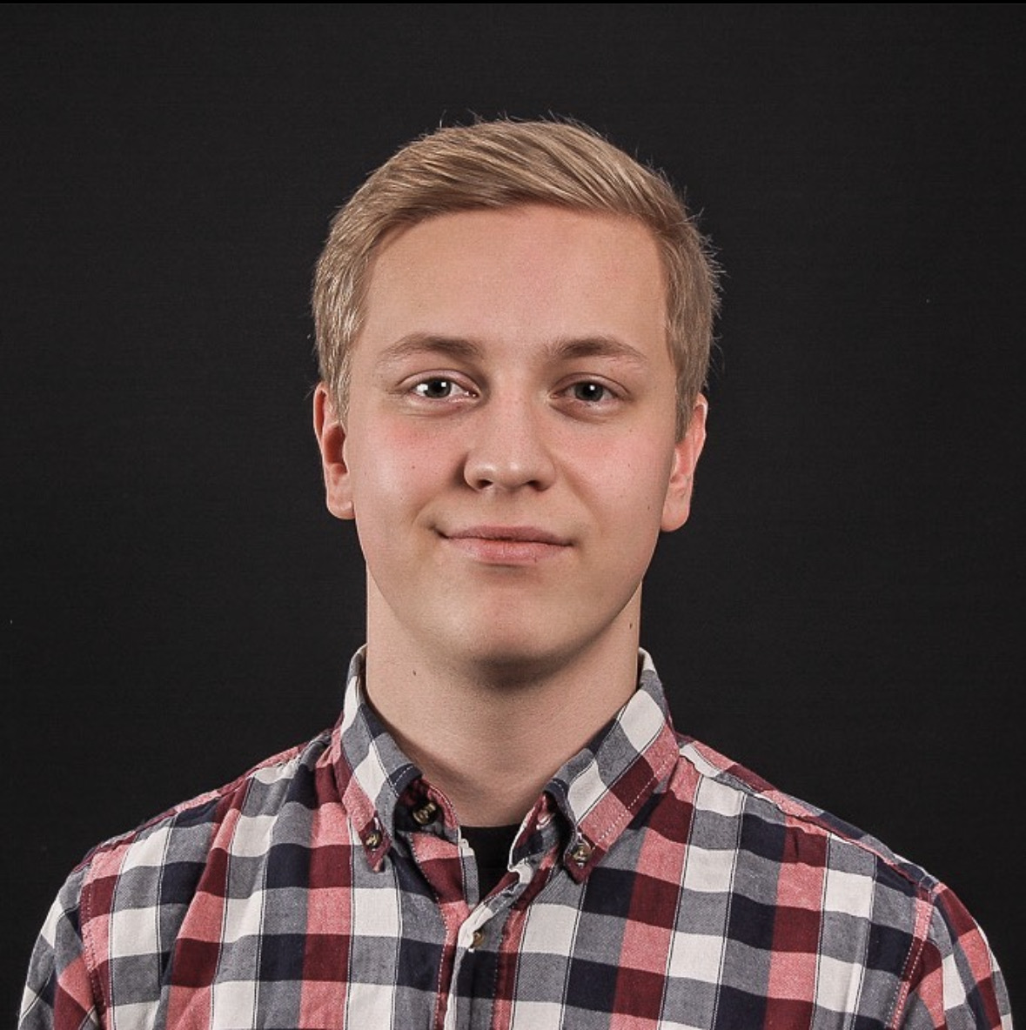
About me
24 yo
Senior Consultant at Innofactor Norway
Experience from creating 2 cost optimization solutions
www.errush.org

Slide 3

The only slide you need
Every piece of code in QR-code
If you miss something contact me

Slide 4

Orphaned disks
Disks without a VM
Intentional or accidental
Pre summer 2022
Now also in Azure Advisor

Slide 5

Old Snapshots
Temporary/short term backup
Routine error
Update golden image

Slide 6


App Gateways and Load Balancers without backend pool
Applies to all LBs
SKU counts
Attached Pip or WAF

Slide 7

Storage v1
Legacy
No tiering or lifecycle management
Price per GB

Slide 8

App Service Plans without apps and stopped webapps
Pay for the app service plan
Scale down

